Slide 1
Proposal to Assist
VF Playwear, Inc. in Evaluating Potential Strategic Options
June 22, 2000

Slide 2
Table of Contents
  Project Background
  Project Objectives
  Project Approach
  Qualifications
  Staffing and Fees
  Appendix A - Resumes
  Appendix B - General Terms and Conditions

Slide 3
Project Background

Slide 4
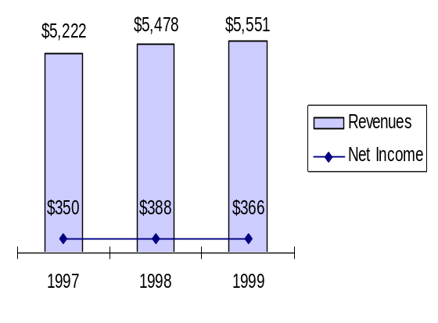
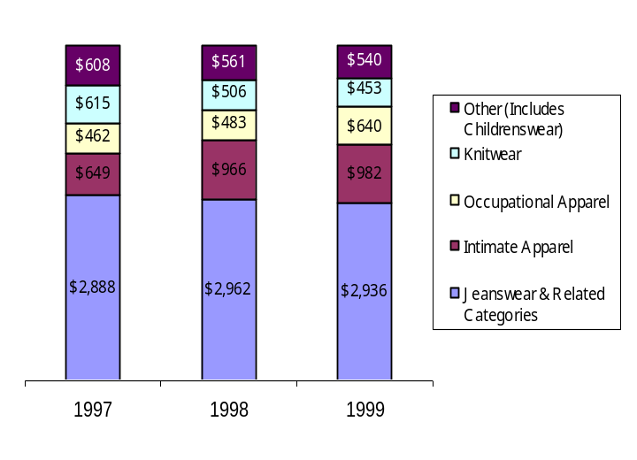
Project Background
Sales and Net Income
VF Corporation
CURRENT SITUATION - VF PLAYWEAR, INC.
  VF Corporation’s Playwear division is at a strategic crossroads
  They have identified three potential opportunities for growth
    By potentially redefining and repositioning their brands, VF Playwear has the opportunity to increase brand awareness and increase sales while maximizing the current trends in the childrenswear retail industry
    By rationalizing their current accounts, VF Playwear can increase productivity and reduce costs
    By entering into the outlet market, VF Playwear has the potential to increase brand awareness and promote sales growth
  However, any viable opportunity would need to enhance the brand, meet internal financial performance goals, and leverage VF Playwear's core competencies
Sales by Division
($ millions)
Source: Company reports

Slide 5
Project Background
THE GROWTH OF CHILDRENS APPAREL SALES
Apparel spending, including infants and toddler apparel, has been strong in the past few years. This growth is propelled by a booming economy, older first-time parents, and grandparents with more money to spend. Continued strong growth in the infants and toddler apparel market is expected over the next five years.
Childrenswear Sales ($ millions)
$29,044
$30,148
$31,338
CAGR 1997-99
Total Apparel 6.8%
Childrenswear 3.9%
Infants & Toddlers 6.4%
Total Childrenswear
Infants & Toddlers
$6,971
$7,125
$7,891
1997
1998
1999
Source: Apparel Market Monitor, AAMA, 2000, PwC analysis

Slide 6
Project Background
CHILDRENS APPAREL SALES BY CHANNEL
Childrens apparel continues to be sold throughout a host of channels. Specialty stores (including The Limited Too, Gap Kids, etc.) have seen the largest share gains in recent years. However, discount/outlet stores continue to maintain the largest share of childrenswear sales, partly due to a value-conscious and time-pressured consumer.
Childrenswear Sales by Channel
$29.0B
$30.1B
$31.3B
2 Year CAGR
7%
7%
6%
7.1%
-0.8%
11%
10%
10%
0.3%
15%
17%
19%
16.1%
Direct Mail
21%
20%
18%
-1.6%
Other Outlets
Percent of Total
Department Stores
Specialty Stores
Major Chains
45%
44%
45%
3.3%
Discount/Outlet
Stores
1997
1998
1999
Year
Source: Apparel Market Monitor, AAMA, 2000, PwC analysis

Slide 7

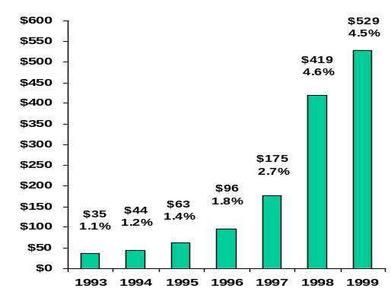
Project Background
THE INCREASING IMPORTANCE AND COST OF BRAND IMAGE
To be successful in the current environment, retailers must leverage the equity of their name or “brand” to differentiate themselves in the marketplace. However, that brand equity comes with a price and a significant investment in marketing is required to communicate your brand to the consumer. Once a brand identity has been determined and communicated to the consumer, changing that identity requires a significant amount of time and additional investment.
Banana Republic's repositioning from safari-inspired clothing to sophisticated clothing took approximately seven years and consisted of a redefinition of the target customer, significant product mix adjustments and fashion styling changes, a substantial marketing investment, store remodels and a new real estate strategy.
Sears' repositioning to the “softer side” took approximately six years. Their strategies for “turning around a $30+ billion battleship” included restructuring the organization, refocusing on a new target customer, remodeling stores, creating new store concepts, adding and enhancing product categories, enhancing technology and intensifying customer service.
Apparel represented approximately 28% of revenues, but was responsible for 60% of profits. To reengineer the apparel business to 40% of total revenues, Sears added floor space, marketing dollars and national brands.
Marketing Dollars Spent, The Gap, Inc.
FY 1993 - 99, in millions (% of sales)
Source: PricewaterhouseCoopers Analysis

Slide 8
Project Background
THE INCREASING IMPORTANCE OF CONSUMER KNOWLEDGE
Consumers' expectations are changing and becoming more complex. While in the past, consumers expected to have a narrow store choice and tended to shop a specific channel, now most shoppers have a broad range of stores to choose from, each offering broad assortments, convenient locations, and low prices. We see customers shopping across channels for different product categories. We also see more and more companies entering the retail market, including CPG manufacturers, telecom companies, credit card companies and non-profit organizations . Additionally, existing retailers are moving into new channels -- both store and non-store. The only way to survive in this complex world it to truly understand your consumers needs and shopping behaviors. A successful company will present one face to the consumer and will use a consistent approach. They will be knowledge-driven, operationally efficient, and feature intelligent pricing.
90’s Mindset
Next Decade Mindset
Consumers have a narrow store choice set
Consumers will stick with you if you do one thing really well
The competition “looks” like you
You can operate in just one channel
Your stores should look alike
Designers build the best lifestyle brands
Mass stores carry the best lifestyle brands
Consumers shop everywhere
Consumers expect more so consumer knowledge is key to customer retention and attraction
The competition is everywhere
You need to be everywhere
Stores need to come in all shapes and sizes
Lifestyle brands can be built by anyone
Lifestyle brands can be bought anywhere
Source: PwC RIS Research, 1999

Slide 9
Project Objectives

Slide 10
Project Objectives
  To review the strategic initiatives identified by VF Playwear, Inc. (VFP)
  To provide VF Playwear with an integrated channel positioning strategy for their brands
  To identify potential childrenswear investment opportunities for VF Playwear
  To rationalize VF Playwear's current accounts
  To analyze and quantify the potential outlet opportunity for VF Playwear
  To generate the financial baseline for the selected strategic initiatives, and model the implications of key positioning and infrastructure requirements
  To determine the next steps required to evaluate these initiatives and ensure their seamless transition to implementation

Slide 11
Project Approach

Slide 12
Project Approach
PRICEWATERHOUSECOOPERS APPROACH
PwC’s approach combines expertise in Strategy, Organization, Process, Information Technology, and Finance to provide an integrated solution that minimizes the risks associated with the implementation of new strategic initiatives. As part of this engagement we will focus on the strategic and financial issues presented by the new initiatives. However, we will also address key process, organization and information technology issues.
Process
What process capabilities are required to support expansion into new channels?
What available alternatives will close the gap?
What will be the anticipated results from adding new capabilities?
Can these capabilities be
leveraged by the existing
organization?
Information Technology
  What additional capabilities are required to support expansion into new channels?
  What is the cost/benefit analysis for these capabilities?
  Can these capabilities be leveraged by the existing organization?
Strategy
  What is the ideal positioning for out brands?
  Are the desired markets attractive?
  Can we differentiate ourselves in the marketplace?
  Will this enhance brand equity?
Organization
Can the new initiatives be
supported by the existing organizational structure?
What investment in human resources is required to successfully implement the new concept?
Finance
  What is the anticipated return from the new initiatives?
  What are the financial implications of the concept on the existing business?
  What are the risks and returns associated with the concept?
  What investments are required?

Slide 13
Project Approach
PROJECT WORKPLAN
This three-phased approach begins with a review of the strategic initiatives using existing materials provided by VF Playwear, Inc. It is then followed by a two-pronged approach that develops a high-level business strategy and plan for the initiatives. During this phase, the initiatives are refined and the potential financial benefits and costs are assessed. In the last phase, the initiatives are integrated into the existing strategic plan and next steps are identified.
Review Strategic Initiatives
Determine Optimal Channel Positioning
Develop Outlet Store Concept
Integrate Initiatives into Current Business Model / Determine Next Steps
1 - 2 weeks
6 - 7 weeks
2 - 3 weeks
This proposal was developed with the understanding that PwC will have access to internal documents regarding customer segmentation and attributes, current financial performance,current product performance, internal process benchmarks, and external market sizing and performance. In addition, it is our assumption that the team will integrate these initiatives into an existing strategic and business plan. In preparing this proposal, we have not assumed costs for additional primary research and purchased secondary research.

Slide 14
Project Approach
REVIEW STRATEGIC INITIATIVES
Sample Deliverables
Strategic Questions
  What is the project scope and its objectives?
  What are the relevant childrenswear market dynamics?
  Who are the target customer groups for each of VFP’s childrenswear brands?
  What is the current channel positioning of their brand portfolio and what is the competitive landscape?
  What are the key appeals of each of the brands?
  How do the market and customer dynamics support the strategic initiatives?
Key Tasks and Considerations
  Initiate the project and confirm scope/objectives
  Review research on US childrenswear apparel market across channels
  Review target customer groups based on VFP’s current data
  Review current channel positioning and competitive landscape based on VFP’s current data
  Review key appeals of each brand based on VFP’s current data
  Review strategic initiatives against market and customer dynamics
Key Deliverables
  Project plan
  Market overview
Market Analysis
Nominal Sales Growth by Retail Channel (5-year CAGR)
Supercenters
9%
24%
34%
Discount
10%
Department Stores
7%
Sporting Goods
9%
Stores
6%
Non-Store
10%
Retailing
5%
7%
Book Stores
5%
CE & Appliance
12%
Stores
4%
Building
8%
Materials/Hardware
4%
9%
Warehouse Clubs
4%
Furniture & Home
6%
Furnishings Stores
3%
7%
Jewelry Stores
2%
Apparel &
3%
Accessory Stores
1%
Shoe Stores
2%
1%
Department Stores
2%
Customer Segmentation
Bargain
Hunters
Time
20%
Pressed
15%
Value
Driven
18%
Lowest
Price
22%
25%
Price
Sensitive

Slide 15
Project Approach
DETERMINE OPTIMAL CHANNEL POSITION
Sample Deliverables
Strategic Questions
  What channels afford the most growth for the Healthtex brand?
  How should each of the brands be positioned within the childrenswear channels of distribution?
  Is there an opportunity for VFP to acquire/license a brand to compete in a channel that they don’t currently compete in?
  What are the financial implications of eliminating or adding channels of distribution?
  Do VFP’s current accounts offer them the strategic and financial support they require?
  Are there any accounts that can potentially be eliminated?
Key Tasks and Considerations
  Analyze current and future profitability of each channel of distribution
  Assess opportunities for VFP brands to move into into different channels of distribution
  Determine criteria for adding new brands to VFP’s portfolio to address new channels of distribution?
  Determine additional infrastructure required to reposition a brand or add a new brand?
  Create financial models for adding/repositioning a brand
  Analyze profitability of current accounts and determine areas for elimination and consolidation
  Key Deliverables
  Channel Positioning / Account Rationalization
  Financial forecast
Account Prioritization
VF Corp.
Provides Competitive
Overriding
Decision
Enhances
Fits with
Provides
Differentiation/
Achieves
Atmosphere
Criteria
Overall
Brand Awareness
Core Customer
Growth
Maintains Competitive Position
Financial
Atmosphere
Assessment
and Image
Current & Future
Opportunities
Objectives
Theme
ACCOUNT A
ACCOUNT B
ACCOUNT C
ACCOUNT D
ACCOUNT E
•
Brand
•
Aligns with
•
High expected
•
Strong, strategic
•
Low capital
enhancing
current core
channel growth
relationship
requirements
•
High profile
customer
•
Provides
•
Absence would be
•
Positive
•
Aligns with
geographic
conspicuous
sales growth
emerging
growth opportunities
•
Value enhancing
consumer segment
Strongly Meets Criteria
Moderately Meets Criteria
Does Not Meet Criteria
Positioning Map
Up
Market
Middle
Market
Opportunity
Down
Market
Represents
Specialty Stores
Young
Singles
Young
Families
Middle Age
Families
Older
Adults
Represents
Department Stores
Represents
Lifestyle Concepts

Slide 16
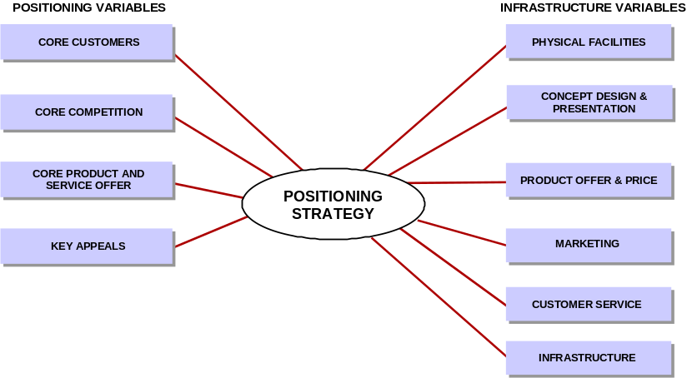
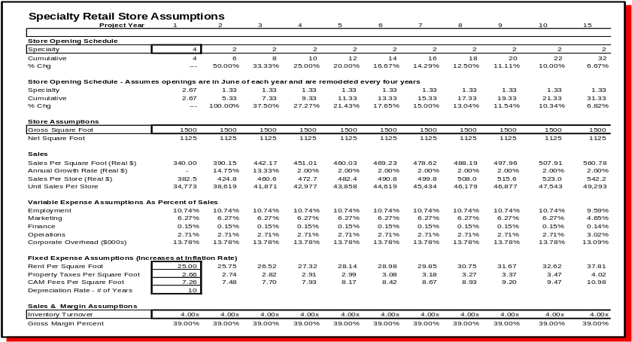
Project Approach
DEVELOP OUTLET STORE CONCEPT
Sample Deliverables
Strategic Questions
  What customer segments will be targeted by this concept?
  Who are the competitors? Are they successful?
  What are the components of a successful business model?
  What is our competitive advantage?
  What assortment should be offered? At what price?
  What are the physical attributes of the concept?
  What is the anticipated financial performance?
Key Tasks and Considerations
  Determine positioning variables: customers, competitors, product, and key appeals. Compare with current positioning to determine impact on existing brand image
  Develop understanding of store attributes and potential types of locations
  Define core product and service offer
  Determine industry benchmarks for strategic, operational, and financial performance?
  Assess current capabilities against baseline retail requirements
  Create financial models and performance scenarios
Key Deliverables
  Strategic plan
  Financial forecast
PricewaterhouseCoopers Retail Positioning Model
Scenario Modeling

Slide 17
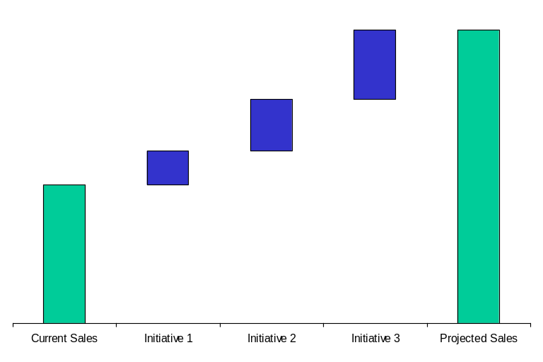
Project Approach
INTEGRATE STRATEGIC INITIATIVES
Sample Deliverables
Strategic Questions
  Do the current initiates support the strategic and financial goals of VF Playwear?
  How will the current initiatives integrate into the overall strategic plan for the division?
  What are the next steps required to bring these initiatives to fruition?
Key Tasks and Considerations
  Analyze the financial implications of all three initiatives relative to the overall financial goals of VFP
  Analyze the strategic implications of the initiatives relative to the mission and vision of VFP
  Determine the next steps required in evaluating these initiatives and plotting their path to implementation
Key Deliverables
  Integrated financials
  Next Steps
Next Steps
Tasks 1 2 3 4 5
Determine Strategic Issues
  Determine individual detailed project plans for execution
  Determine how resources will be organized and secured to execute
Determine Key Tasks and Considerations
  Develop real estate plan
  Develop marketing and promotion plans
  Develop account rationalization plan
  Establish reporting requirements and systems
  Implement
Determine Key Milestones/Deliverables
  Detailed rollout and migration plan
  Store design specifications
  Store opening, in-store, and marketing strategy and materials
Sales Contribution
$100M
$425M
$75M
$50M
$200M

Slide 18
Our Qualifications

Slide 19

Qualifications
KEY BUSINESS ISSUES:
Additional growth strategies in response to flat revenues
Improved profitability and increased shareholder value
SOLUTION APPROACH:
Determine the profitability of existing products and markets
Assess the viability of new products and markets using a greenfield approach
Develop financial models
Identify impact on current organization
Develop detailed execution plans
RESULTS:
Comprehensive corporate strategy and implementation plan
Significant increase in profitability through the elimination of structurally unprofitable businesses
Short-term profit improvements through the development of product line extensions and licensing agreements
Combined outlet formats for increased profitability

Slide 20

Qualifications
KEY BUSINESS ISSUES:
Additional growth strategies outside of their current market segment
Increase brand awareness and attract new customers to the brand
Increase EPS
Leverage current infrastructure
SOLUTION APPROACH:
Conduct consumer research to test viability of concept
Develop retail strategy and concept
Develop financial models
Identify impact on current organization
Determine additional infrastructure requirements
RESULTS:
Viable strategic positioning and
retail concept
Concept to comprise 60% of company’s sales in five years
Detailed five year business plan that exceeded company IRR hurdle rate
Defined impact on existing organization
Store roll-out strategy

Slide 21

Qualifications
KEY BUSINESS ISSUES:
Additional growth strategies outside of traditional catalog retailing
Leverage existing customer base
Coordinate all channels, including retail stores, catalog, and internet
Leverage current infrastructure
SOLUTION APPROACH:
Develop retail strategy and concept
Partner with branding and store design firms to ensure that the strategy and concept is accurately incorporated into final deliverables
Develop financial models
Identify impact on current organization
Determine additional
infrastructure requirements
Develop detailed execution plans
RESULTS:
Viable strategic positioning and concept
Concept to double sales volume over seven years
Five year business plan that exceeds company hurdle rates for IRR
Minimal impact to organization in early years
Actionable implementation plans - First store opens in mid 2000

Slide 22

Qualifications
KEY BUSINESS ISSUES:
Additional growth strategies outside of traditional catalog retailing
Expose brand to new customers
Create synergies across all channels,
including retail stores, catalog, and internet
Leverage current infrastructure, create opportunities to upgrade current processes and systems
SOLUTION APPROACH:
Develop retail strategy and concept
Develop financial models
Provide support to Retail President in meetings with store design firm to ensure that designs meet customer expectations within the context of the economic model
Identify impact on current organization
Determine additional infrastructure requirements
Develop detailed execution plans
RESULTS:
Viable strategic positioning and concept
Concept to double sales volume
in three years
Five year business plan that meets company expectations for profitability and growth
Defined impact on existing organization and strategies to mitigate risk
Actionable implementation plans - First store opens in late 1999

Slide 23

Qualifications
KEY BUSINESS ISSUES:
Additional growth strategies outside of traditional wholesale retailing
Increase brand awareness and attract new customers to the brand
Support expansion into new markets
Coordinate all channels, including retail stores, catalog, and internet
Minimize risk to corporate organization
SOLUTION APPROACH:
Conduct consumer research to identify customer’s preferences
Develop retail strategy and concept
Develop financial models for retail channel
Meet with internal store design group to set requirements for RFP for external design firms
Identify effect on current organization and determine additional infrastructure requirements
Develop detailed execution plans
RESULTS:
Viable strategic positioning and
retail concept
Concept to comprise 45% of division profits in five years
Detailed five year business plan that exceeded company IRR hurdle rate
Defined operational and logistical requirements necessary for retail success
Defined impact on existing organization
Actionable implementation plans for both new and existing outlets- first store opens in late 2000

Slide 24

Qualifications
KEY BUSINESS ISSUES:
Additional growth strategies building on brand strength and recognition
Convert retail shoppers into
cruise shoppers
Determine critical cruise experiences
and apply to retail concept
Create synergies across all service channels, including retail stores,
cruise services, and internet
SOLUTION APPROACH:
Develop retail strategy and concept
Develop financial models
Identify impact on current organization
Determine additional
infrastructure requirements
Develop detailed execution plans
Determine partner selection in all areas
RESULTS:
Viable strategic positioning and concept
Significant capital commitment - in excess of $25 million
First major store lease signed by mid - 2000
Defined impact on existing organization and strategies to mitigate risk

Slide 25

Qualifications
KEY BUSINESS ISSUES:
Validate conceptual need for
chef-prepared home meal
replacement in food production
“theatre” environment
Determine critical success factors
and core competencies required
Leverage current infrastructure
SOLUTION APPROACH:
Conduct consumer research to
determine specific needs
Perform operations and
technology assessment
Define corporate and personnel
skills set requirements
Develop detailed execution plans
RESULTS:
Viable strategic positioning and concept
Actionable implementation plans
Successful launch
Turnkey plans & rollout strategy

Slide 26

Qualifications
KEY BUSINESS ISSUES:
Update strategy to respond to changes in competitive intensity and changed consumer demands
Optimal organizational structure and processes to support new positioning
Leverage select operational skills
SOLUTION APPROACH:
Extensive customer research to identify competitive strengths
and opportunities
Identify and evaluate various alternative product offers
Finance based scenario
modeling based on various
economic possibilities
Work with senior team to focus organization through strategic initiatives and internal support
RESULTS:
New strategic business plan
with significantly improved revenues
Comprehensive set of
implementable tactics

Slide 27

Qualifications
KEY BUSINESS ISSUES:
Develop vision of retail concept and associated revenue stream model
Leverage purchasing and distribution strengths
Identify supply chain improvements
in select areas
SOLUTION APPROACH:
Develop retail strategy
and concept
Develop financial models
Identify impact on current organization
Determine additional
infrastructure requirements
Develop detailed execution plans
RESULTS:
Viable new retail concept -
“convenience store of the future”
Best in class supply chain practices
Defined impact on existing organization and strategies to mitigate risk
New operating platform utilizing
current technology

Slide 28

Qualifications
KEY BUSINESS ISSUES:
Update strategy to respond to changes
in competitive intensity
Optimal organizational structure and processes to support new positioning
Tailor store assortments to local market needs while leveraging infrastructure
SOLUTION APPROACH:
Extensive customer research to identify competitive strengths and opportunities
Work with senior team to focus organization through strategic
initiatives and internal support
Assess merchandising opportunities
and develop integrated systems to facilitate local assortments
RESULTS:
New mission statement for organization
Comprehensive set of strategic initiatives
Merchandising process reengineered to plan, allocate, and market locally while minimizing disruptions to existing staff
Required changes to functional systems documented to facilitate implementation

Slide 29

Qualifications
KEY BUSINESS ISSUES:
Customer store preferences shift towards better department stores and upmarket apparel shops (1996)
Declining company performance
Continued strength of brand equity
in question
SOLUTION APPROACH:
Apply detailed, proprietary consumer research methodology
Work closely with top management
and Board of Directors to evaluate opportunities and formulate strategies
Facilitate discussions, guide decision-making through fact-based analysis,
and assist in developing operational
and financial plans
Establish performance metrics to monitor progress against agreed milestones
RESULTS:
3 year income growth outpaced apparel store index by 95%
Customer-driven business strategy with detailed implementation plans
Long-term business relationship valued by both parties

Slide 30
Staffing, Timing and Fees

Slide 31
Staffing
PROPOSED PROJECT TEAM
We propose an integrated project team comprised of VF executives and PricewaterhouseCoopers professionals representing the full range of relevant industry and functional areas of expertise.
Project Sponsor
Gary Simmons
President
VF Playwear, Inc.
VFP Leadership Team
Cross-functional team of 5-6 individuals
TBD
PwC Project Partner
Jennifer Crites
Project Manager
Kari LePage
Principal Consultant
Strategic Change
Retail
Subject Matter Experts
Christa Hart
Distribution / Logistics (TBD)
IT (TBD)
Real Estate (TBD)
Project Team
Shantha Farris Kim Albataew TBD
Senior Consultant Senior Consultant Consultant
Strategic Change Strategic Change Strategic Change
Retail Retail Retail

Slide 32
Project Timing
PLAN
CONDUCT
WEEKS
MEETING
1
2
3
4
5
6
7
8
9
10
11
12
Project Planning Meeting
Phase A - Assess & Validate Strategic Initiatives
  Initiate the project and confirm scope/objectives
  Evaluate external business environment and review internal resources
Phase B1 - Determine Optimal Channel Positioning
Channel Positioning Meeting/Account Rationalization
  Analyze channels of distribution and determine most attractive ones for VF
  Assess channel repositioning opportunities
  Identify most attractive accounts, and determine opportunities for elimination
Financial & Strategic Implications Meeting
  Determine infrastructure required to support initiatives
  Determine financial and strategic implications
A
Phase B1

Slide 33
Project Timing
PLAN
CONDUCT
WEEKS
MEETING
1
2
3
4
5
6
7
8
9
10
11
12
Phase B2 - Develop Outlet Store Concept
Channel Positioning Meeting/Account Rationalization
  Determine concept positioning including customers, competitors, core product and service offer, and key appeals
  Develop understanding of store attributes and potential types of locations
Financial & Strategic Implications Meeting
Phase C - Integrate Initiatives and Identify Next Steps
  Analyze financial and strategic implications of all initiatives relative to overall goals of the division
  Determine next steps required to evaluate these initiatives further
Final Presentation Meeting
  Present strategy for outlet store concept and channel positioning strategy
Phase B2
Phase C

Slide 34
Project Fees
PricewaterhouseCoopers welcomes the opportunity to partner with VF Playwear, Inc. on this important engagement. After thorough consideration of the project scope and staffing requirements, we have estimated the total professional fees for this engagement to be $ 825,000. These fees cover the deliverables and tasks outlined in Phase 1: Review Strategic Initiatives through Phase 3: Integrate Initiatives and Determine Next Steps. Because VF Corporation is a valued client and PwC wants to support VF in this extraordinary effort, a valued client discount of 20% will be offered making the final professional fees $ 660,000.
This is a not-to-exceed quote, provided there is no change in project scope. We expect the project to be completed within 12 weeks of the formal starting date, assuming sufficient client involvement and access to required information.
VF Corporation will also be responsible for the actual cost of out-of-pocket expenses such as travel and report preparation. These costs are estimated not to exceed 15% to 20% of professional fees. Professional fees and expenses are invoiced monthly and are payable with Net 30-day terms.
PricewaterhouseCoopers thanks you for inviting us to present our proposal for this exciting engagement. We would like to express our high level of interest in partnering with VF Playwear, Inc. to pursue these opportunities further.

Slide 35
Appendix A - Resumes

Slide 36
Resumes
Jennifer Crites
Position
  Partner, PricewaterhouseCoopers / Management Horizons - Retail Practice, New York, NY
Range of Experience
  Over 15 years of consulting and industry experience helping clients to develop and implement business strategies and process change.
Professional Experience
  Most recently Ms. Crites was the Senior Vice President of Retail for Calvin Klein, Inc. where she was responsible for the Company’s owned and franchised stores worldwide. While at Calvin Klein, Inc., Ms. Crites also held the position of Vice President, Strategic Planning and was responsible for many of the company’s internal restructuring and global expansion initiatives.
  Prior to joining Calvin Klein, Inc., Ms. Crites was a Senior Manager with Management Horizons division of Price Waterhouse, LLP. There Ms. Crites was responsible for directing the strategic consulting activities for the Northeast Region. Ms. Crites specialized in developing customer driven market positioning strategies for retailers and apparel manufacturers which assisted them in achieving sales and profit improvements. Additionally, Ms. Crites identified strategic refinement and restructuring opportunities in the areas of competitive positioning, merchandising, product development and sourcing, merchandise planning and allocation, international expansion and organizational effectiveness. Ms. Crites also authored reports regarding relevant industry trends and critical issues and delivered presentations at many client and industry conferences.
Education
  MBA, Ohio State University, Columbus, OH
  BSBA - Accounting, Ohio State University, Columbus, OH

Slide 37
Resumes
Christa Hart
Position
  Principal Consultant, PricewaterhouseCoopers / Management Horizons - Strategic Change Practice, Atlanta, GA
Range of Experience
  Prior to joining Management Horizons, Ms. Hart was employed for eleven years in various channels of the retail industry including positions with Wet Seal, Crystal Brands and The May Company. She has credentials in: buying, merchandise and assortment planning, inventory management, replenishment, and sales.
Professional and Business Experience
  Managed a project to develop a restaurant concept for a consumer packaged goods company. Identified positioning for the new concept including customer, merchandise mix, pricing, and competitors. Developed a detailed financial plans to validate the concept. Defined execution and process requirements and developed implementation plans.
  Developed a turnaround strategy for a retailer in bankruptcy. Identified specific recommendations to improve store contribution, merchandise assortment and profitability, inventory turnover, effectiveness of marketing and advertising.
  Led the development of a retail store strategy for a specialty women’s apparel catalog. Identified positioning for the new concept, including customer, merchandise mix, and competitors. Defined execution and process requirements for merchandising, logistics, information technology, and finance. Identified gaps in organizational structure and skill sets.
  Determined the financial viability of a potential merger between several discount/department store operations. Developed operational strategy based on best practices for merchandising processes, identified supporting organizational structures and skill sets, and determined information technology required to support new processes.

Slide 38
Resumes
Christa Hart
  Developed a retail operations reorganization recommendation for a manufacturer/retailer of softgoods that included field management, store, and corporate support organizational structures, staffing and financial models, and an implementation plan.
  Led a retail channel expansion/new store concept development project for an apparel and sporting goods catalog company. Identified target customer, merchandise mix, primary and secondary competitors, and key areas of differentiation. Defined execution requirements, such as store size and layout, real estate strategy, in-store merchandising standards, pricing, customer service, and support systems (information technology, logistics, and human resources). Developed implementation plans.
  Worked with an upscale women’s specialty store to identify issues impacting comp store sales. Facilitated teams in the development of strategic initiatives to improve merchandise presentation, and to integrate financial, assortment, and merchandise planning.
  Completed an assessment of potential business opportunities for a major specialty retailer. Provided analysis of economic trends, current competitors and suppliers, as well as, customer acceptance and market forecasts.
  Created a methodology and application to obtain optimal category assortments at store level for a leading jewelry manufacturer. Led workshops to disseminate this methodology throughout the organization. Worked to improve the profitability of vendor-managed inventories for troubled accounts and new implementations throughout the United States.
Education
  MBA, The Anderson School at UCLA, Los Angeles, CA
  BS, Business Administration - Materials Management, Arizona State University, Tempe, AZ

Slide 39
Resumes
Kari LePage
Position
  Principal Consultant, PricewaterhouseCoopers / Management Horizons - Strategic Change Practice, New York, NY
Range of Experience
  Prior to joining Management Horizons, Ms. LePage was employed for five years with the Gap, Inc. in San Francisco. She worked in the strategic planning department and helped position the Gap brands, as well as develop the Old Navy brand. She has extensive knowledge in customer and competitive positioning and financial planning.
Professional and Business Experience
  Led a project to develop a restaurant concept for a consumer packaged goods company. Identified positioning for the new concept including customer, merchandise mix, pricing, and competitors. Developed a detailed financial plans to validate the concept. Defined execution and process requirements and developed implementation plans.
  Developed a retail channel expansion/new store concept strategy for an apparel and sporting goods catalog company. Identified target customer, merchandise mix, primary and secondary competitors, and key areas of differentiation. Defined execution requirements, such as store size and layout, real estate strategy, in-store merchandising standards, pricing, customer service, and support systems (information technology, logistics, and human resources).
  Led a project to develop a new children’s apparel concept. Tested viability of concept and identified positioning including target customer, merchandise mix and competitive positioning. Developed detailed financial plans to validate the concept. Defined execution and process requirements and identified gaps in current capabilities
  Determined the financial viability of a potential merger between several discount/department store operations. Developed operational strategy based on best practices for merchandising processes, identified supporting organizational structures and skill sets, and determined information technology required to support new processes.

Slide 40
Resumes
Kari LePage
  Led a business assessment of a homegoods/apparel retailer. Assessed long-term viability of concepts and recommended strategic positioning changes. Identified areas of opportunity in store size and layout, merchandise mix, pricing, customer service and support systems.
  Led an assessment of potential business opportunities for a major specialty retailer. Provided analysis of economic trends, in-depth analysis of competitive set, as well as, customer acceptance and market forecasts.
  Led a project to determine organizational structure for potential merger of two specialty retailers. Identified best practices for multi-divisional retailers and recommended potential solution. Identified transition management approach.
Education
  MBA, The Stern School of Business at NYU, New York, NY
  BA, Economics / Computer Science, Rutgers University, New Brunswick, NJ

Slide 41
Resumes
Shantha G. Farris
Position
  Consultant, PricewaterhouseCoopers - Strategic Change Retail Practice, New York
Range of Experience
  Prior to joining PricewaterhouseCoopers, Ms. Farris’ professional history includes international retailing and marketing experiences. She has worked extensively with retailers to develop positioning strategies especially in the areas of merchandising, customer development and marketing.
Professional and Business Experience
  Determined target market profiles and service offering strategy for a global business-to-consumer portal. Identified potential market segments. Analyzed the eMarketplace as well as traditional channels to evaluate opportunities and risks. Completed primary and secondary research.
  Designed a new merchandising organization for a general merchandise retailer. Completed primary and secondary research to benchmark industry best practices. Quantified benefits and costs. Incorporated technology changes into the five year plan. Used gap analysis methodology to determine the effects of this technological change on the merchandising organization.
  Developed a customer development strategy. Performed potential market sizing for a business-to-business e-commerce opportunity. Established criteria for target customer segments. Determined price sensitivity and service requirements through primary as well as secondary research.
  Developed a new retail concept business plan. Benchmarked best practices through industry research. Determined a merchandise assortment plan consistent with target customer information. Created economic models to select best alternative for the retail concept. Conducted research to evaluate best rollout strategy. Qualified the implications of various ownership structures.

Slide 42
Resumes
Shantha G. Farris
  Developed buying and inventory management training tools for a specialty retailer. Analyzed product life cycle implications of conversion to a cost based inventory system. Conducted interviews within merchandising organization to determine project requirements.
Education
  Executive MBA, Marketing, Rutgers University
  Graduate Diploma in Financial Management, Finance, Singapore Institute of Management
  BA, Psychology, Dartmouth College

Slide 43
Resumes
Kim Albataew
Position
  Consultant; PricewaterhouseCoopers LLP; New York, NY
Range of Experience
  Broad range of experience across the public and private sectors, including retail and consumer packaged goods. Expertise in helping clients develop robust business strategies and determining their mission and vision. Additional expertise in conducting competitive analysis and economic analysis.
Professional Experience
  Led a project to develop a B2C strategy for a consumer packaged goods company. Identified positioning strategy including target consumers, merchandise offer, competitors, and key appeals. Identified possible business models to pursue and determined the viability of each. Defined execution requirements including elements of website design and exploration of partnership opportunities.
  For a leading grocery retailer, developed training materials on strategic positioning for use at strategic planning workshops. Conducted competitive analysis, including research on channel dynamics. Analyzed and compiled customer satisfaction survey results. Assisted in the development of consumer research conducted by an outside vendor, including questionnaire development and analysis of results. Facilitated leadership development workshops.
  Completed a competitive analysis of thought leadership programs at professional services firms. Conducted interviews with alumni of other firms, developed an interview template and determined the relevance of issues/questions. Conducted research into current trends and best practices in thought leadership, including trends in other industries and thought leadership efforts by other practice areas. Analyzed competitor interviews and other research results. Presented final results to the Global Marketing Team. Provided insight to the development of the governance model and final presentation document.

Slide 44
Resumes
Kim Albataew
Professional Experience
  For a leading professional services firm, acted as primary liaison for practice-area group providing input to a cross-functional team developing a consolidated service offerings database. Gathered information on practice-area services offered to clients. Coordinated with practice-area leaders the creation and collection of summaries of service offerings. Verified information received from practice area leaders and ensured the quality of the data. Researched other tools and methodologies used in client engagements, then summarized and formatted them to fit database template.
  Managed the development of new product enhancements for the credit card registration service of a leading diversified financial services company. Created and implemented innovative pricing strategy expected to increase enrollment in the service. Conducted focus groups and participated in consumer brainstorming sessions. Assessed the viability of new distribution channels for the service.
Education
  MBA, Columbia Business School, Columbia University, New York, NY
  BA, Rutgers University, New Brunswick, NJ

Slide 45
Appendix B - General Terms and Conditions

Slide 46
General Terms and Conditions
1. Entire Agreement. These General Terms and Conditions and the engagement letter (and its attachments) or the proposal (and its attachments), as the case may be, to which these General Terms and Conditions are attached (collectively, the "Agreement") constitutes the entire agreement between the client (“VF Corporation”) to whom such engagement letter is addressed or to whom such proposal is submitted, as the case may be, and PricewaterhouseCoopers LLP, a limited liability partnership organized under the laws of the State of Delaware ("PwC"), regarding the project described in the engagement letter or the proposal, as the case may be. If PwC has commenced work in connection with the matters described in the engagement letter (and its attachments) or the proposal (and its attachments), as the case may be, to which these General Terms and Conditions are attached, all provisions in this Agreement for the benefit or protection of either party shall apply to such activities. There are no prior or contemporaneous, oral or written, representations, understandings or agreements which are not fully expressed in this Agreement. No amendment, change order, waiver or discharge shall be valid unless it is in writing and signed by an authorized representative of the party against whom such amendment, change order, waiver or discharge is sought to be enforced. In the event of a conflict between these General Terms and Conditions and the engagement letter (and its attachments) or proposal (and its attachments) to which they may be attached, these General Terms and Conditions shall control.
2. Relationship of Parties. PwC, in furnishing services to the Client, is an independent contractor. PwC does not undertake to perform any regulatory or contractual obligation of the Client or to assume any responsibility for the Client's business or operations. PwC shall supervise, perform or cause to be performed all work to be accomplished by PwC and may call upon the expertise and/or assistance of its Price Waterhouse affiliates in the performance of such services. To the extent that circumstances permit, PwC is committed to offering its staff a lifestyle which enables them to control their travel schedules. Accordingly, if PwC’s staff is required to work away from home for extended periods, to the extent consistent with PwC’s performance obligations, the Client agrees to accept flexibility in the way PwC’s staff divides their time between the Client’s sites and their home base. Except as may be otherwise agreed in writing by the Client and PwC, during the term of this Agreement and for twelve (12) months thereafter, neither the Client nor PwC, nor any of their respective affiliates, shall offer employment to or employ any person employed then or within the preceding twelve (12) months by the other or any affiliate of the other if such person was involved, directly or indirectly, in the performance of this Agreement.
3. Taxes. There shall be added to the charges under this Agreement, and the Client shall pay to PwC, an amount equal to any taxes, levies and duties, however designated or levied, domestic or foreign, based upon such charges, this Agreement, the services or materials provided, or their use, including without limitation state and local sales and use taxes, which are paid by or are payable by PwC, plus interest and penalties, if any, exclusive, however, of United States federal, state or local taxes based on the net income of PwC. Should Client be required under any law or regulation of any governmental entity or authority, domestic or foreign, to withhold or deduct any portion of the payments due to PwC, then the sum payable to PwC shall be increased by the amount necessary to yield to PwC an amount equal to the sum it would have received had no withholdings or deductions been made. Notwithstanding two preceding sentences, PwC accepts full and exclusive liability for the payment of all employer contributions and taxes measured by the remuneration paid to PwC employees as required by all applicable United States federal, state and local laws, rules and regulations.

Slide 47
General Terms and Conditions
4. Warranties. PwC warrants that the services provided will be performed and supervised by qualified personnel. NOTWITHSTANDING ANYTHING TO THE CONTRARY CONTAINED IN THIS AGREEMENT, PwC MAKES NO OTHER WARRANTIES, EXPRESS OR IMPLIED, OR WHETHER ARISING BY OPERATION OF LAW, COURSE OF PERFORMANCE OR DEALING, CUSTOM, USAGE IN THE TRADE OR PROFESSION OR OTHERWISE, INCLUDING WITHOUT LIMITATION IMPLIED WARRANTIES OF MERCHANTABILITY AND FITNESS FOR A PARTICULAR PURPOSE. Except as expressly provided in the engagement letter, PwC is not providing any Year 2000 services (for example, Year 2000 assessment, conversion or testing), nor making any warranties with respect to the products or services provided by PwC or by third parties under this Agreement to correctly process, provide and/or receive date data within and between the twentieth and twenty-first centuries. Except for the warranty expressly set forth in this Paragraph 4, the Client acknowledges and agrees that it has relied on no other representations or warranties and that no other representations or warranties have formed the basis of its bargain hereunder.
5. Indemnity. (a) PwC and the Client each agree to indemnify, defend and hold harmless the other from and against any and all amounts payable under any judgment, verdict, court order or settlement for death or bodily injury or the damage to or loss or destruction of any real or tangible personal property to the extent arising out of the indemnitor's negligence in the performance of this Agreement.
(b) PwC agrees to indemnify, defend and hold harmless the Client from and against any and all amounts payable under any judgment, verdict, court order or settlement to the extent resulting from any unaffiliated third party allegation that the work performed by PwC under this Agreement infringes such third-party's United States patent, copyright or trade secret. Should the Client's use of work performed by PwC be determined to have infringed, or if, in PwC's judgment, such use is likely to be infringing, PwC may, at its option: (1) procure for the Client the right to continue to use the work performed by PwC; or (2) replace or modify the work performed by PwC to make its use non-infringing while yielding substantially equivalent results. If neither of such options are or would be available on a basis that PwC finds commercially reasonable, PwC may terminate this Agreement, the Client shall return work performed to PwC and PwC shall refund the fees paid for the associated services, less a reasonable allowance for use. The Client reserves any other legal or equitable rights or remedies it may have. This indemnity does not cover alleged infringements caused by modifications to the work performed by PwC that are not made by PwC or that result from the Client provided designs, specifications or other information or from combination of such work with products or services not provided by PwC.
(c) The indemnities in this Paragraph 5 are contingent upon: (1) the indemnified party promptly notifying the indemnifying party in writing of any claim which may give rise to a claim for indemnification hereunder; (2) the indemnifying party being allowed to control the defense and settlement of such claim; and (3) the indemnified party cooperating with all reasonable requests of the indemnifying party (at the indemnifying party's expense) in defending or settling such claim. The indemnified party shall have the right, at its option and expense, to participate in the defense of any action, suit or proceeding relating to such a claim through a counsel of its own choosing.

Slide 48
General Terms and Conditions
6. Limitation of Liability. Other than the Client's obligations to make payments that are due and owing under this Agreement, a party's and its affiliates' entire and collective liability arising out of or relating to this Agreement, including without limitation on account of performance or nonperformance of obligations hereunder, regardless of the form of the cause of action, whether in contract, tort (including without limitation negligence), statute or otherwise, shall in no event exceed the amounts paid to PwC under this Agreement. NOTWITHSTANDING ANYTHING TO THE CONTRARY CONTAINED IN THIS AGREEMENT, NEITHER PARTY NOR ITS AFFILIATES SHALL, UNDER ANY CIRCUMSTANCES, BE LIABLE TO THE OTHER PARTY OR ITS AFFILIATES FOR ANY CLAIM BASED UPON ANY THIRD PARTY CLAIM (EXCEPT AS PROVIDED FOR IN PARAGRAPH 5) OR FOR ANY CONSEQUENTIAL, INCIDENTAL, INDIRECT, PUNITIVE, EXEMPLARY OR SPECIAL DAMAGES OF ANY NATURE WHATSOEVER, OR FOR ANY DAMAGES ARISING OUT OF OR IN CONNECTION WITH ANY MALFUNCTIONS, DELAYS, LOSS OF DATA, LOSS OF PROFIT, INTERRUPTION OF SERVICE OR LOSS OF BUSINESS OR ANTICIPATORY PROFITS, EVEN IF A PARTY OR ITS AFFILIATES HAVE BEEN APPRISED OF THE LIKELIHOOD OF SUCH DAMAGES OCCURRING. No action, regardless of form, arising out of this Agreement may be brought by either party more than one (1) year after the cause of action has accrued.
7. Ownership. Title to all written material, originated and prepared for the Client under this Agreement, shall belong to the Client. However, PwC's working papers and PwC Confidential Information (as defined below) belong exclusively to PwC. The ideas, concepts, know-how, techniques, inventions, discoveries, improvements and other information relating to information processing, telecommunications or business process re-engineering or design, developed during the course of this Agreement by PwC and/or Client personnel, may be used by either party, without an obligation to account, in any way it deems appropriate, including without limitation by or for its clients or customers, notwithstanding any provision in this Agreement to the contrary. PwC is in the business of providing consulting services and developing computer software for a wide variety of clients and the Client understands that PwC will continue these activities. Accordingly, nothing in this Agreement shall preclude or limit PwC from providing consulting services and/or developing software or materials for itself or other clients, irrespective of the possible similarity of screen formats, structure, organization and sequence to materials which might be delivered to the Client.

Slide 49
General Terms and Conditions
8. Confidentiality. PwC agrees that all financial, statistical, marketing and personnel data relating to the Client's business, and other information identified as confidential by the Client, are confidential information of the Client ("Client Confidential Information"). The Client agrees that PwC's System Management Methodology, Change Integration® Methodology and proprietary software, tools and other methodologies (including without limitation its ChangePro™ software tool, KnowledgeView database and software, BetterTech tools, and its industry and taxonomies templates), and any other information identified as confidential by PwC, are confidential information of PwC ("PwC Confidential Information"). Client Confidential Information and PwC Confidential Information are collectively referred to as "Confidential Information." Each party shall use Confidential Information of the other party which is disclosed to it only for the purposes of this Agreement and shall not disclose such Confidential Information to any third party, without the other party's prior written consent, other than to PwC's subcontractors and to each other's employees on a need-to-know basis. Each party agrees to take measures to protect the confidentiality of the other party's Confidential Information that, in the aggregate, are no less protective than those measures it uses to protect the confidentiality of its own Confidential Information, but at a minimum, each party shall take reasonable steps to advise their employees (and, in the case of PwC, its subcontractors) of the confidential nature of the Confidential Information and of the prohibitions on copying or revealing such Confidential Information contained herein. PwC and the Client each agree to require that the other party's Confidential Information be kept in a reasonably secure location. Notwithstanding anything to the contrary contained in this Agreement, neither party shall be obligated to treat as confidential, or otherwise be subject to the restrictions on use, disclosure or treatment contained in this Agreement for, any information disclosed by the other party (the "Disclosing Party") which: (1) is rightfully known to the recipient prior to its disclosure by the Disclosing Party; (2) is generally known or easily ascertainable by non-parties of ordinary skill in computer or process design or programming or in the business of the Client; (3) is released by the Disclosing Party to any other person, firm or entity (including governmental agencies or bureaus) without restriction; (4) is independently developed by the recipient without any reliance on Confidential Information; or (5) is or later becomes publicly available without violation of this Agreement or may be lawfully obtained by a party from any nonparty. Neither party will be liable to the other for inadvertent or accidental disclosure of Confidential Information if the disclosure occurs notwithstanding the party's exercise of the same level of protection and care that such party customarily uses in safeguarding its own confidential information.

Slide 50
General Terms and Conditions
9. Deliverables, Misc. Client will notify PwC, in writing within ten working days of its receipt of any PwC deliverable under this Agreement, whether or not the deliverable is accepted. If the deliverable is not accepted, the notice will specify in reasonable detail the reasons that the deliverable fails to meet the requirements described in this Agreement in all material respects. Acceptance by Client will not be unreasonably withheld. The passage of ten working days without notice of nonacceptance by Client, or use by Client of the deliverable, will constitute acceptance by Client of the deliverable. PwC will take reasonable measures to remedy any failure of the deliverable to meet the requirements described in this Agreement in all material respects. Unless otherwise specifically agreed by PwC and Client for a particular deliverable, any deliverable which has been accepted as described above or which is used by the parties as the basis for subsequent deliverables, will be considered to supersede (and prevail in the event of any conflict with) any preceding deliverable created or provided pursuant to this Agreement. The parties agree that a date or schedule contained in this Agreement is important to achieve, but nonetheless represents an estimate and will likely will be revised during the course of carrying out the services. However, PwC will use all reasonably practical and diligent efforts to achieve the date or schedule.
10. Binding Nature and Assignment. This Agreement shall be binding upon and inure solely to the benefit of the parties hereto and their successors and permitted assigns, and nothing in this Agreement shall confer upon any other person or entity any legal or equitable right, benefit or remedy of any nature whatsoever under or by reason of this Agreement, save for the parties' affiliates as expressly provided in Paragraph 6, Limitation of Liability. Neither party may, nor shall have the power to assign or transfer this Agreement without the prior written consent of the other party, except that PwC may without consent assign or transfer this Agreement to a successor to the business of PwC to which this Agreement relates. Any claim relating to the provision of services by PwC, its affiliates or their respective staff will be made against PwC alone. The rights and obligations of the parties under these General Terms and Conditions shall survive termination of this Agreement for any reason. Without limiting the restrictions on PwC contained in Paragraph 8, Confidentiality, PwC may refer to this engagement as an experience citation with its clients and prospects.
11. Approvals and Similar Actions. Where agreement, approval, acceptance, consent or similar action by the Client or PwC is required under this Agreement, such action shall not be unreasonably delayed or withheld.
12. Choice of Law. This Agreement will be governed by and construed in accordance with the laws of the State of New York, without giving effect to the conflicts of laws provisions thereof.

